Slide 1
CSE 4128 Image Processing and Computer Vision Laboratory
Dr. Sk. Md. Masudul Ahsan
Professor
Dept. of CSE, KUET
Dipannita Biswas
Lecturer
Dept. of CSE, KUET

Slide 2
Course Outlines
WEEK 1 | Convolution
WEEK 2 | Segmentation applying edge detection and thresholding
WEEK 3 | Histogram equalization and matching
WEEK 4 | Frequency Domain Filtering
WEEK 5 | Region Descriptors
WEEK 6 | Project Showcasing

Slide 3
Week 1
Topic: Convolution

Slide 4
Image Processing
Image processing is converting an image to a digital format and applying various functions to it to create a better image or extract additional information from it.
Digital Image: is present in pixelated form.
Grayscale Image: Every pixel size is one byte and has a variation of 256 colors from black to white.
Color Image: composed of multiple color channels, each representing the intensity of a specific color or perceptual feature. The most common color models:
RGB(Red, Green, Blue),
HSI(Hue, Saturation, Intensity), and
HSV(Hue, Saturation, Value).

Slide 5
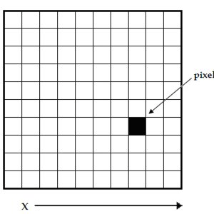
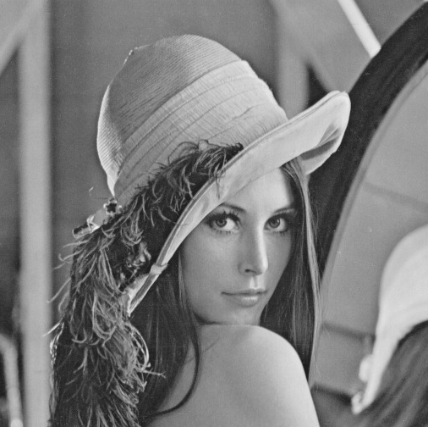
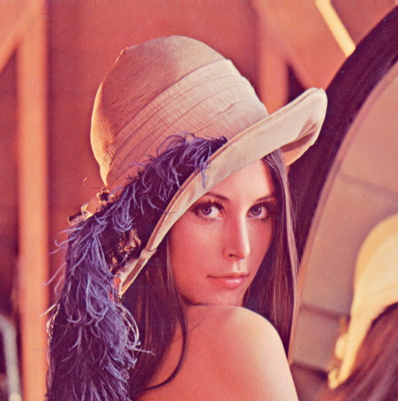
Digital Image
x
y
Grayscale Image
Color image in RGB space

Slide 6
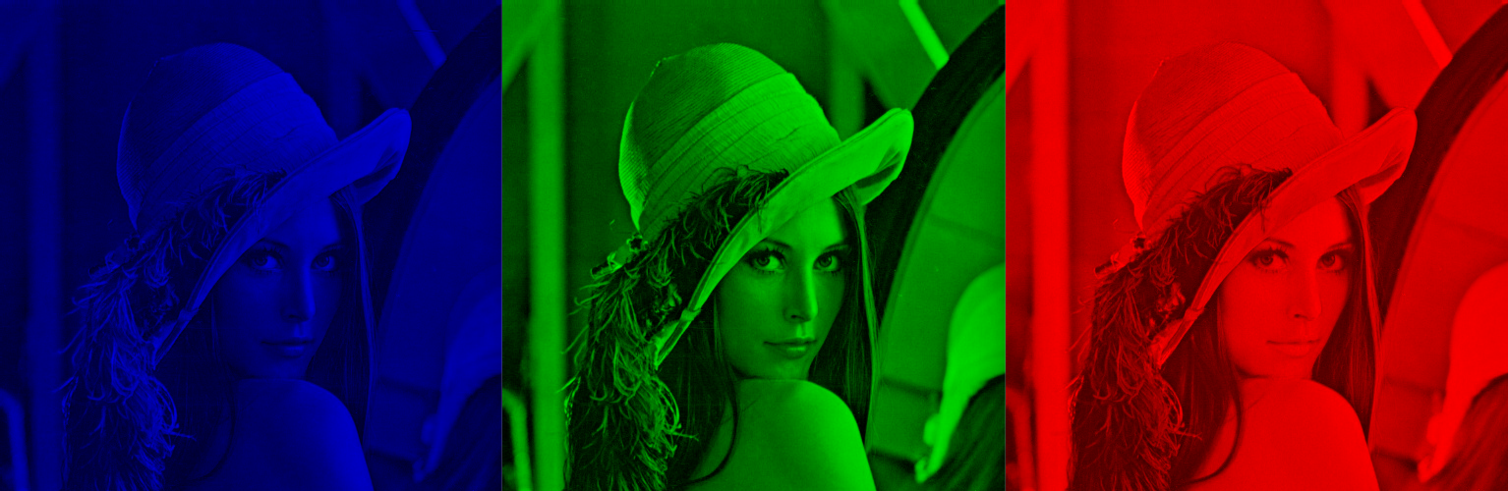
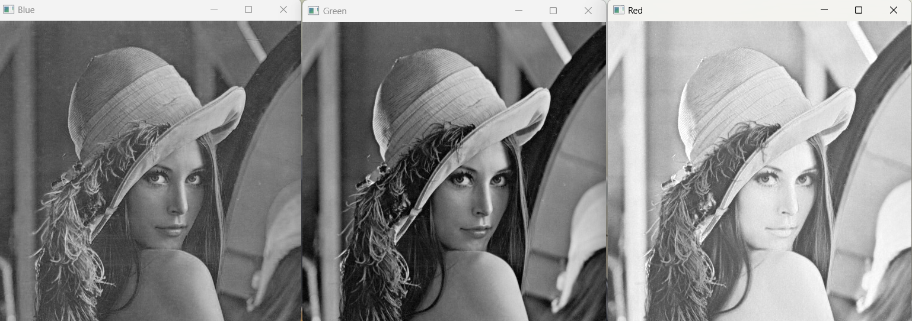
Digital Image
Color image in RGB space
Figure(Left to right): Blue, Green, Red Channel

Slide 7
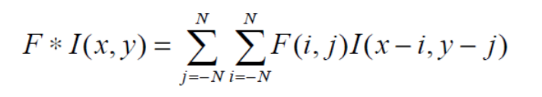
Convolution
Convolution is an operation performed on two functions to produce a third function.
In image processing, convolution is the process of transforming an image by applying a kernel over each pixel and its local neighbors across the entire image.
The convolution operation applied on Image I(x,y) using a kernel F is given by

Slide 8
Convolution
1 | 1 | 0 | 1 | 0
0 | 0 | 1 | 0 | 0
0 | 1 | 0 | 0 | 1
1 | 0 | 1 | 0 | 1
0 | 1 | 1 | 1 | 0
0 | 0 | 0 | 0 | 0
0 | 0 | 0 | 0 | 0
0 | 0 | 0 | 0 | 0
0 | 0 | 0 | 0 | 0
0 | 0 | 0 | 0 | 0
1 | 2 | 3
4 | 5 | 6
7 | 8 | 9
F
I(X,Y)
F * I(X,Y)

Slide 9
Convolution
1X9 | 1X8 | 0X7 | 1 | 0
0X6 | 0X5 | 1X4 | 0 | 0
0X3 | 1X2 | 0X1 | 0 | 1
1 | 0 | 1 | 0 | 1
0 | 1 | 1 | 1 | 0
0 | 0 | 0 | 0 | 0
0 | 23 | 0 | 0 | 0
0 | 0 | 0 | 0 | 0
0 | 0 | 0 | 0 | 0
0 | 0 | 0 | 0 | 0
1 | 2 | 3
4 | 5 | 6
7 | 8 | 9
F
I(X,Y)
F * I(X,Y)

Slide 10
Convolution
1 | 1X9 | 0X8 | 1X7 | 0
0 | 0X6 | 1X5 | 0X4 | 0
0 | 1X3 | 0X2 | 0X1 | 1
1 | 0 | 1 | 0 | 1
0 | 1 | 1 | 1 | 0
0 | 0 | 0 | 0 | 0
0 | 23 | 24 | 0 | 0
0 | 0 | 0 | 0 | 0
0 | 0 | 0 | 0 | 0
0 | 0 | 0 | 0 | 0
1 | 2 | 3
4 | 5 | 6
7 | 8 | 9
F
I(X,Y)
F * I(X,Y)

Slide 11
Convolution
1 | 1 | 0 | 1 | 0
0 | 0 | 1 | 0 | 0
0 | 1 | 0 | 0 | 1
1 | 0 | 1 | 0 | 1
0 | 1 | 1 | 1 | 0
0 | 0 | 0 | 0 | 0
0 | 23 | 24 | 15 | 0
0 | 0 | 0 | 0 | 0
0 | 0 | 0 | 0 | 0
0 | 0 | 0 | 0 | 0
1 | 2 | 3
4 | 5 | 6
7 | 8 | 9
F
I(X,Y)
F * I(X,Y)

Slide 12
Convolution
1 | 1 | 0 | 1 | 0
0 | 0 | 1 | 0 | 0
0 | 1 | 0 | 0 | 1
1 | 0 | 1 | 0 | 1
0 | 1 | 1 | 1 | 0
0 | 0 | 0 | 0 | 0
0 | 23 | 24 | 15 | 0
0 | 16 | 0 | 0 | 0
0 | 0 | 0 | 0 | 0
0 | 0 | 0 | 0 | 0
1 | 2 | 3
4 | 5 | 6
7 | 8 | 9
F
I(X,Y)
F * I(X,Y)

Slide 13
Convolution
1 | 1 | 0 | 1 | 0
0 | 0 | 1 | 0 | 0
0 | 1 | 0 | 0 | 1
1 | 0 | 1 | 0 | 1
0 | 1 | 1 | 1 | 0
0 | 0 | 0 | 0 | 0
0 | 23 | 24 | 15 | 0
0 | 16 | 16 | 0 | 0
0 | 0 | 0 | 0 | 0
0 | 0 | 0 | 0 | 0
1 | 2 | 3
4 | 5 | 6
7 | 8 | 9
F
I(X,Y)
F * I(X,Y)

Slide 14
Convolution
1 | 1 | 0 | 1 | 0
0 | 0 | 1 | 0 | 0
0 | 1 | 0 | 0 | 1
1 | 0 | 1 | 0 | 1
0 | 1 | 1 | 1 | 0
0 | 0 | 0 | 0 | 0
0 | 23 | 24 | 15 | 0
0 | 16 | 16 | 17 | 0
0 | 0 | 0 | 0 | 0
0 | 0 | 0 | 0 | 0
1 | 2 | 3
4 | 5 | 6
7 | 8 | 9
F
I(X,Y)
F * I(X,Y)

Slide 15
Convolution
1 | 1 | 0 | 1 | 0
0 | 0 | 1 | 0 | 0
0 | 1 | 0 | 0 | 1
1 | 0 | 1 | 0 | 1
0 | 1 | 1 | 1 | 0
0 | 0 | 0 | 0 | 0
0 | 23 | 24 | 15 | 0
0 | 16 | 16 | 17 | 0
0 | 21 | 0 | 0 | 0
0 | 0 | 0 | 0 | 0
1 | 2 | 3
4 | 5 | 6
7 | 8 | 9
F
I(X,Y)
F * I(X,Y)

Slide 16
Convolution
1 | 1 | 0 | 1 | 0
0 | 0 | 1 | 0 | 0
0 | 1 | 0 | 0 | 1
1 | 0 | 1 | 0 | 1
0 | 1 | 1 | 1 | 0
0 | 0 | 0 | 0 | 0
0 | 23 | 24 | 15 | 0
0 | 16 | 16 | 17 | 0
0 | 21 | 20 | 0 | 0
0 | 0 | 0 | 0 | 0
1 | 2 | 3
4 | 5 | 6
7 | 8 | 9
F
I(X,Y)
F * I(X,Y)

Slide 17
Convolution
1 | 1 | 0 | 1 | 0
0 | 0 | 1 | 0 | 0
0 | 1 | 0 | 0 | 1
1 | 0 | 1 | 0 | 1
0 | 1 | 1 | 1 | 0
0 | 0 | 0 | 0 | 0
0 | 23 | 24 | 15 | 0
0 | 16 | 16 | 17 | 0
0 | 21 | 20 | 22 | 0
0 | 0 | 0 | 0 | 0
1 | 2 | 3
4 | 5 | 6
7 | 8 | 9
F
I(X,Y)
F * I(X,Y)

Slide 18
Python as Task Language
Ease of readability and ease of learning
Extensive libraries present, the majority are open source and free.
Generally slower than C++ in terms of raw performance but more user-friendly.
Libraries:
OpenCV (Open Source Computer Vision Library)
Pillow (PIL Fork)
NumPy
Matplotlib
Notes:
(as C++ is syntactically complex and needs manual memory management).

Slide 19
OpenCV
OpenCV is faster than PIL
OpenCV and PIL both can do general image manipulation and processing tasks.
It also can perform certain computer vision-specific operations, unlike PIL, like object detection, feature extraction, image segmentation, etc.
Integrates well with libraries like NumPy, scikit-learn, TensorFlow, and other computer vision and machine learning libraries.

Slide 20
Installation
Download Anaconda installer.
Installation link: https://docs.anaconda.com/anaconda/install/
OpenCV installation on Anaconda prompt:
pip install opencv-python
pip install opencv-contrib-python
For updating pip: python -m pip install --upgrade pip

Slide 21
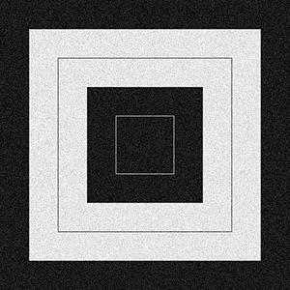
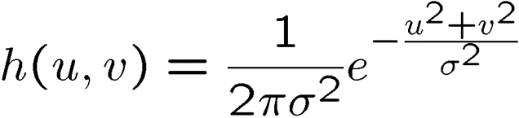
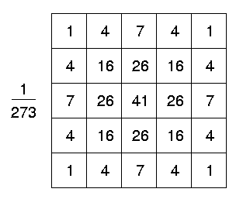
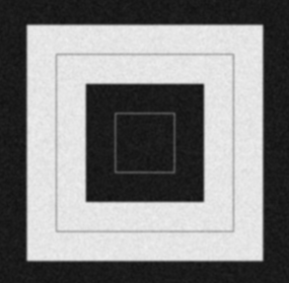

Classwork
Input
Output

Slide 22
Classwork
Apply Prewitt operator using Convolution:
It works like as first order derivate and calculates the difference of pixel intensities in a edge region.
-1 | 0 | 1
-1 | 0 | 1
-1 | 0 | 1
-1 | -1 | -1
0 | 0 | 0
1 | 1 | 1
G_{x} will find the edges in the horizontal direction
G_{y} will find edges in the vertical direction

Slide 23

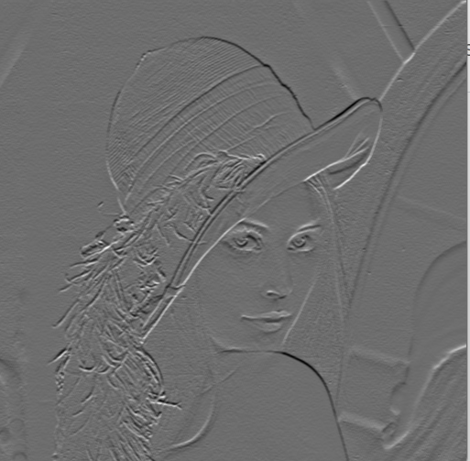
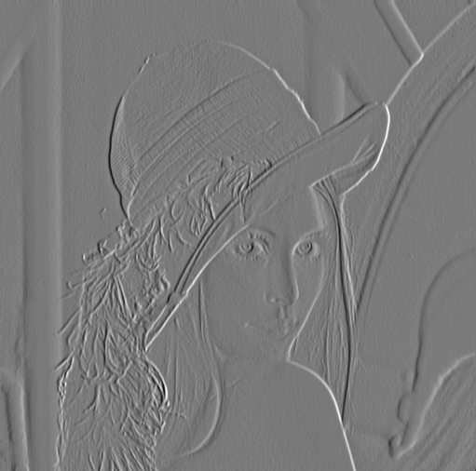
Classwork
Input
Applying G_{x}
Applying G_{y}

Slide 24
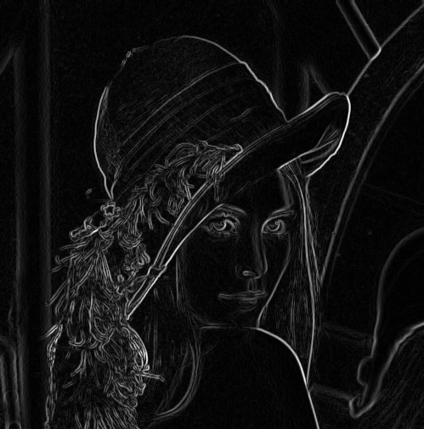

Gradient Magnitude

Slide 25
Assignment
Apply Convolution using both smoothing and sharpening kernels on a grayscale image and output the results.
Repeat the process for the Color image:
Take an RGB image and apply convolution with each kernel, applying convolution separately on each channel.
Convert the RGB image to HSV mode and apply convolution with each kernel, applying convolution separately on each channel of HSV space.
Subtract the resulting image obtained from the RGB and HSV modes to distinguish their differences.
Repeat (2) for both smoothing and sharpening kernels.

Slide 26
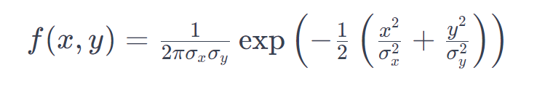
Assignment
Instructions for Filters:
The center of each kernel should be user-defined. Don’t fix it in the center.
Use smoothing filters like the Gaussian blur filter and Mean filter.
For the Gaussian filter, create a filter function with parameters σ_{x}, σ_{y} (which will be user-input) such that it satisfies:
Use Sharpening filters like the Laplacian filter, and Laplacian of a Gaussian (LoG) filter for each operation.
Try with the Sobel filter.

Slide 27
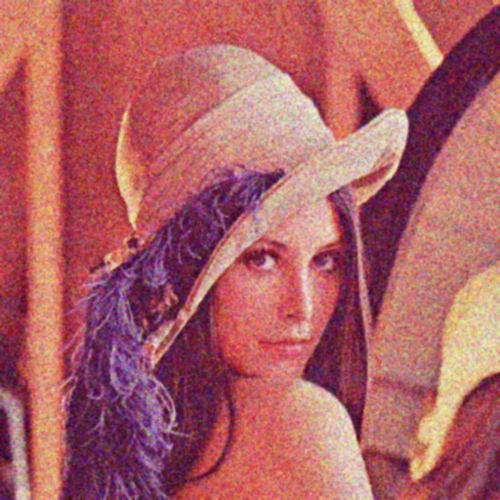

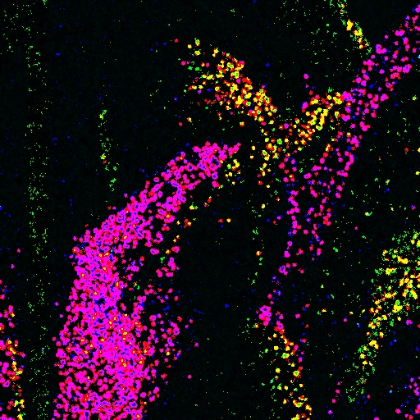

Assignment(Example)
Applying Gaussian filter
Convoluted in RGB space
Input image
Difference between the outputs
Convoluted in HSV space

